Slide 1

Sparse and Redundant Representations and Their Applications in
Signal and Image Processing
(236862)
Winter Semester, 2018/2019
Michael (Miki) Elad

Slide 2
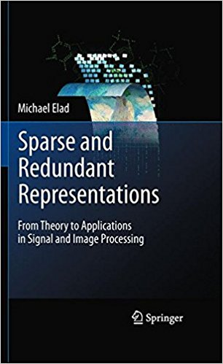
Few Details
Lecturer | Michael Elad Reception hours: anytime, set by email Office 711 in Taub, Phone # 4169
Teaching Assistant | Alona Golts
Credit | 3 points
Time and Place | Thursday, 10:30-12:30, Room: Ulman 102
Prerequisites | Image processing: 236327, 236860 or 046200. Numerical algorithms: 234125 Graduate students are not obliged to these requirements
Literature | Recently published papers and the book "Sparse and Redundant Representations- From Theory to Applications in Signal and Image Processing" that can be found in the library

Slide 3
Course Content
This course is all about … Sparseland – a new and extremely effective way to model data
Sparseland leads to a systematic way to give birth to all the fields of signal and image processing in a unified and axiomatic way
This model which stands at the center of our course, led to an amazing revolution in data processing in general, and specifically in image processing and machine learning
Sparseland and Example-Based Models

Slide 4
Course Content
Signal Processing
Machine Learning
Mathematics
Wavelet Theory
Approximation Theory
Multi-Scale Analysis
Sparseland and Example-Based Models
Linear Algebra
Optimization Theory
Signal Transforms
Interpolation
Source-Separation
Semi-Supervised Learning
Segmentation
Identification
Inverse Problems
Denoising
Classification
Compression
Clustering
Prediction
Recognition
Anomaly detection
Sensor-Fusion
Synthesis

Slide 5
Course Content
Will review ~20 years of tremendous progress in the field of
Sparse and Redundant Representations
Numerical Problems
Applications (image processing)
Theory

Slide 6


Course Format
This course has been taught in the Technion in the past decade, and was quite successful
We kept updating it from time to time, adjusting to new discoveries and recent work, as this field matured
Since last year, the rules of the game have changed due to this …
MOOC

Slide 7
Course Format
A year ago, Yaniv Romano and I worked hard to convert this course into a MOOC (Massive Open Online Course), serviced through EdX (2 parts)
This means that the material we cover can now be taught through short videos and interactive work over the Internet
On October 21th, 2018, this MOOC started, open to anyone
MOOC

Slide 8
Technion’s Students: Course Format
You will be learning this course with the MOOC, just like others all around the world
In addition (1):
We will hold weekly meetings to discuss the material of the past week, answer questions, and bring additional material.
Your presence in these meeting is MANDATORY. Two absences are OK, and beyond that you lose 5% (from the final grade) per each lost meeting
In addition (2): You will perform a final project on a recent paper in this field [more details next]
Note that the course has a very unusual format, and its load has been upgraded to 3 points

Slide 9
Technion’s Students: Requirements
There will be 5 wet HW assignments within the EdX course and various quizzes. The wet HW concentrate on Matlab/Python* implementation of algorithms that will be discussed in class
The course requirements include a final project to be performed by singles or pairs based on recently published papers [a list will be shared with you]. The project will include
A final report (10-20 pages) summarizing your assigned papers, their contributions, and your own findings (open questions, simulation results, etc.).
A Power-point presentation of the project to be presented to the course lecturer by the end of the semester.
Deadline for project submission: April 30th. No delays are allowed.
More on the project can be found in the course webpage

Slide 10
Technion’s Students
Grading:
50% - The MOOC Grade
50% - the Project grade (content, presentation, and report)
Free listeners are welcome – both in the MOOC and in class
If you plan to join us this semester, formally or informally, please send an email to both Alona Golts (zadneprovski@gmail.com) and me
Technion’s students do not need to pay for their course on edX
Course webpage (for the Technion’s students): It can be easily found under my own webpage

Slide 11

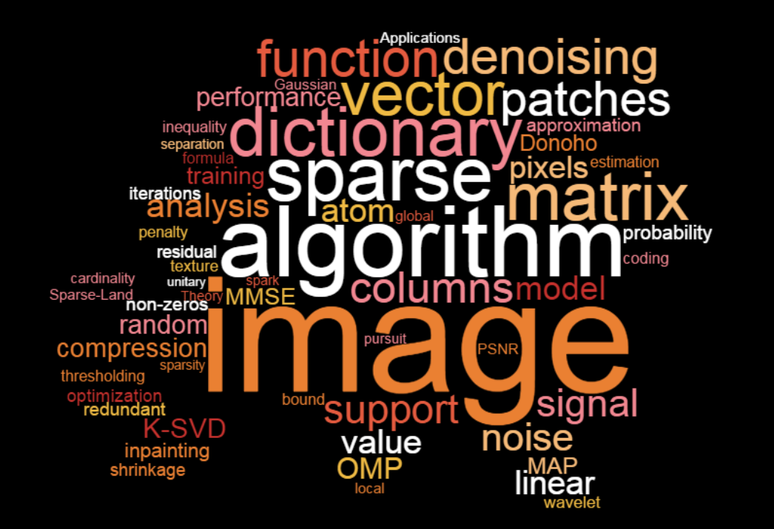

Questions?

Slide 12

The edX Platform and Beyond
CS-236862

Slide 13

edX Platform

Slide 14
Register to edX

Slide 15
Enrollment to The Course
If you are taking the Technion course (236862) for credit, please send zadneprovski@gmail.com the email linked to your edX account, along with the username so we could keep track of your progress

Slide 16
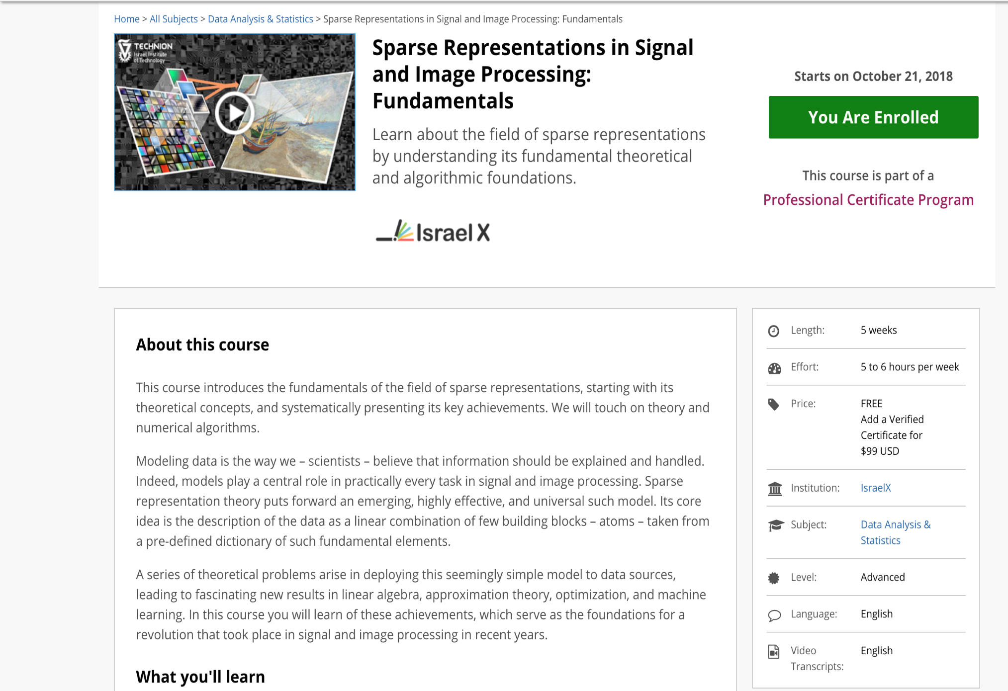
This course is free of charge for those who take the Technion’s course !!

Slide 17
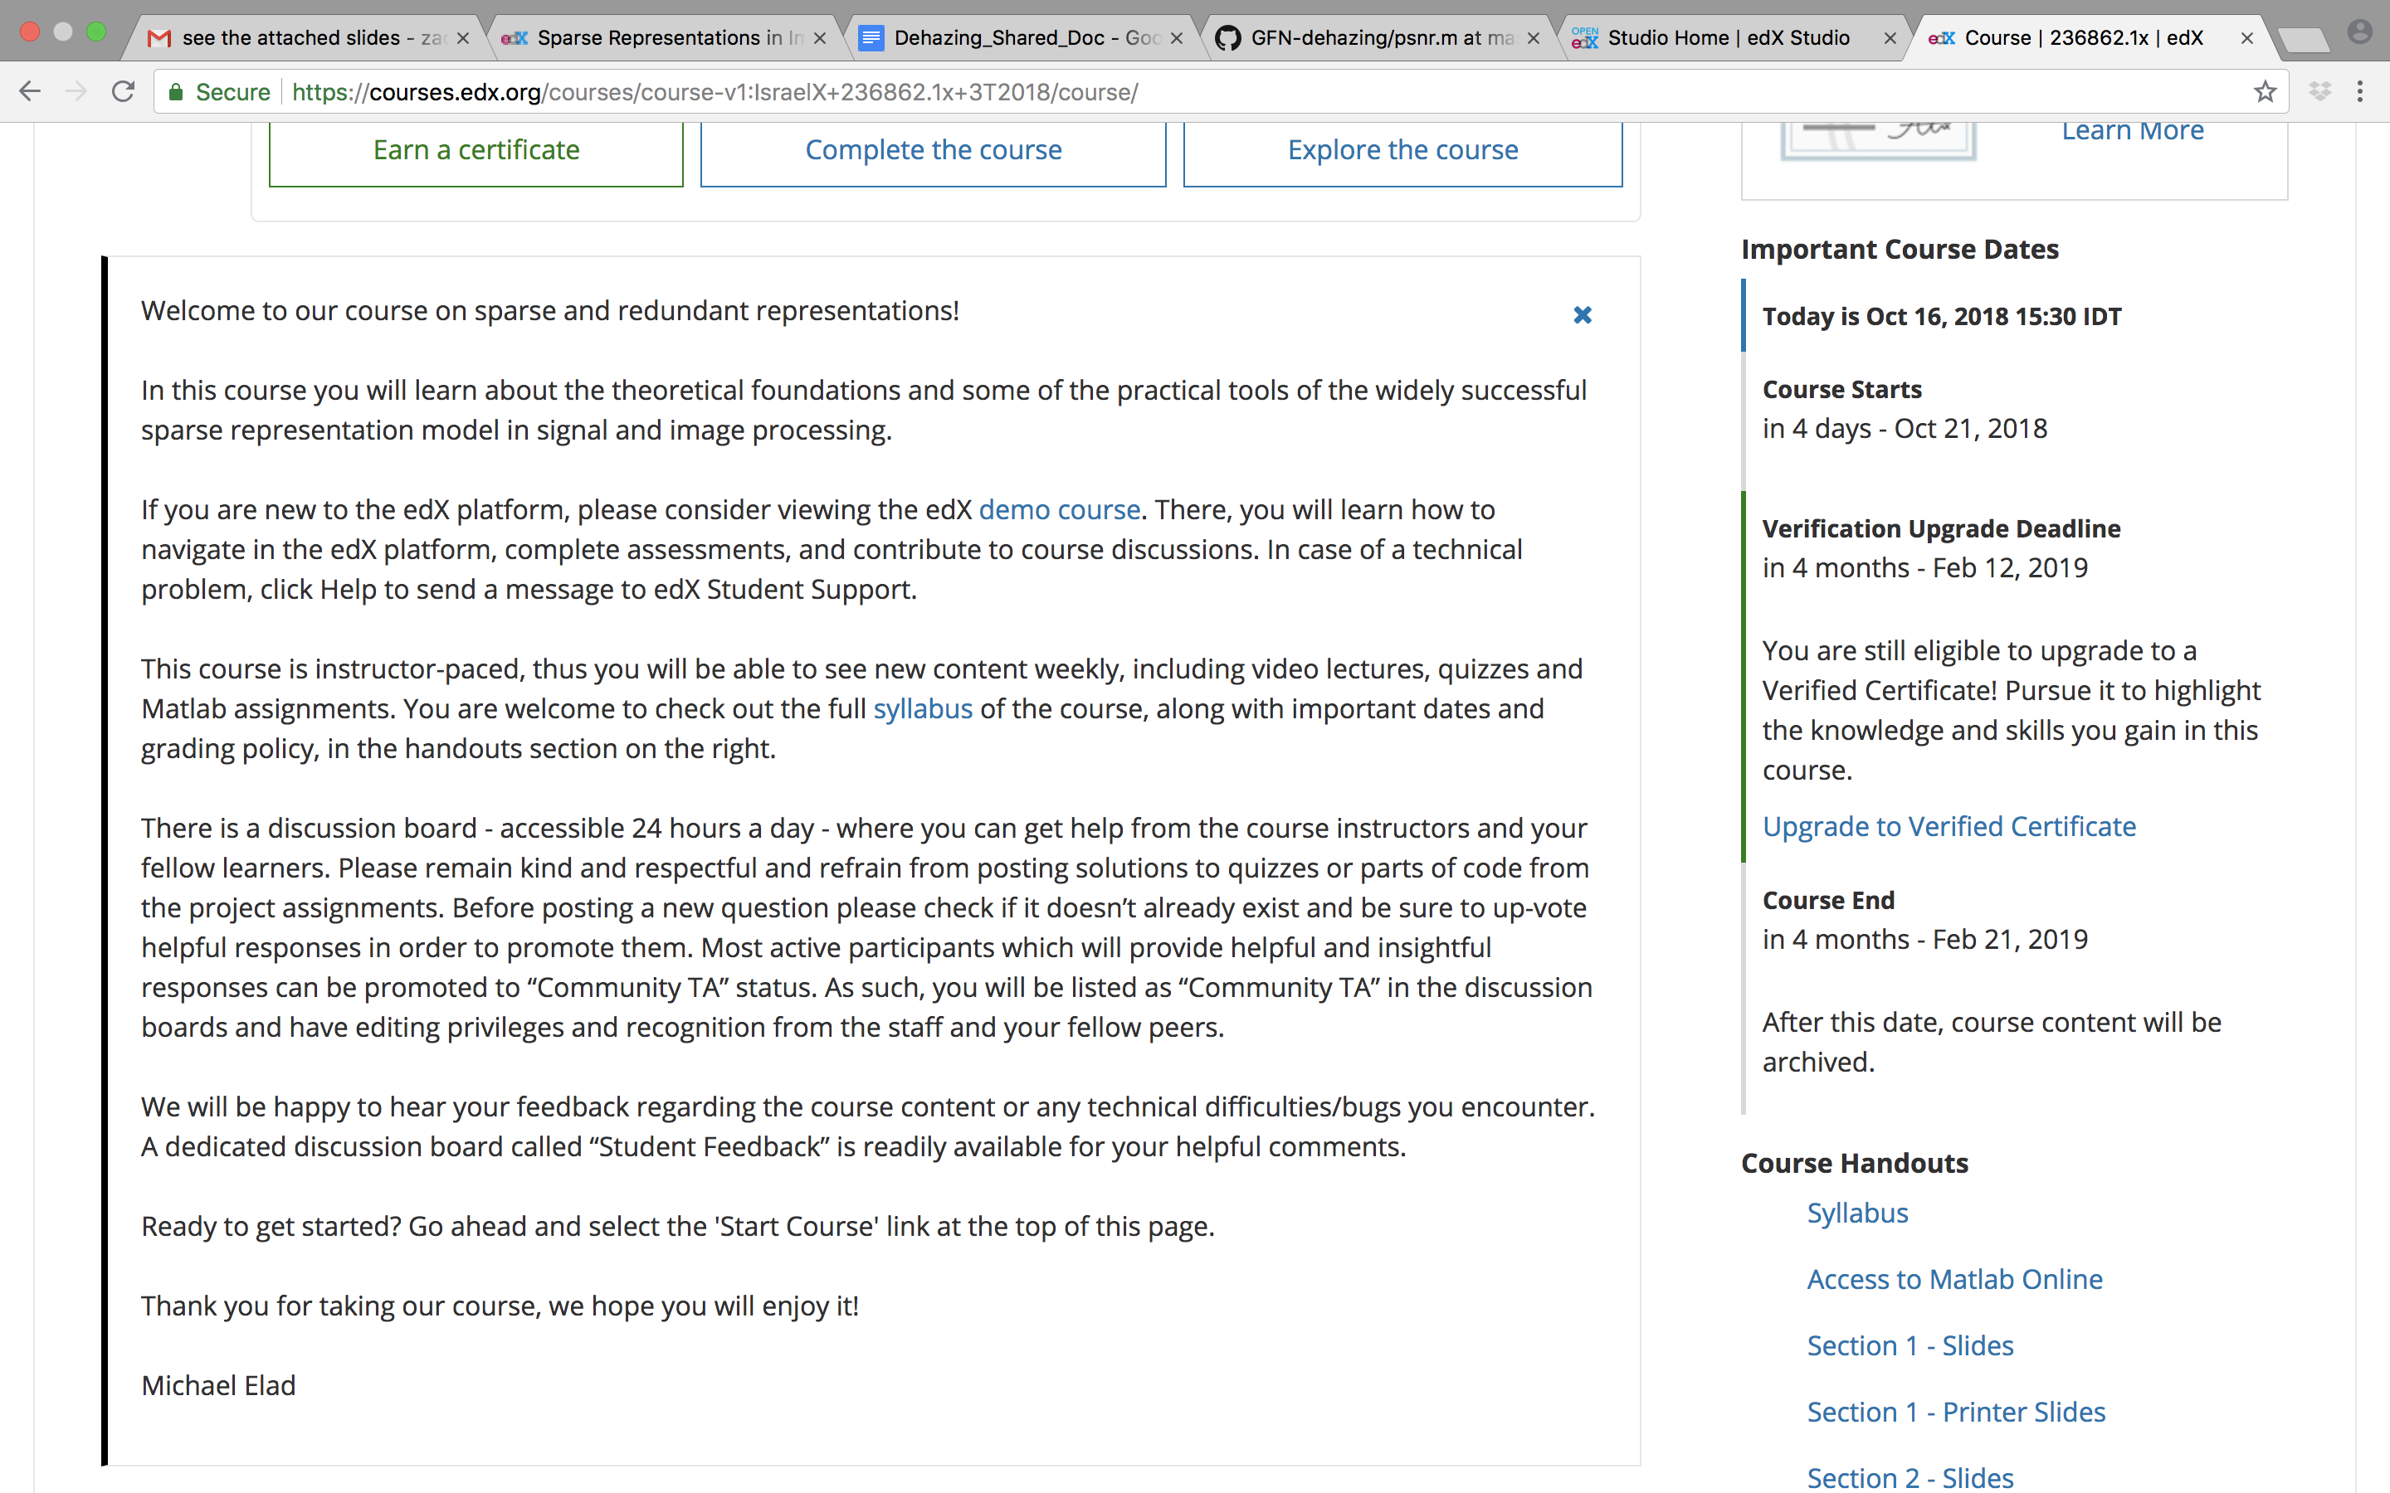

Slide 18
About the Program
Professional Certificate Program Sparse Representations in Signal and Image Processing
First Course Sparse Representations in Signal and Image Processing: Fundamentals
Second Course Sparse Representations in Image Processing: From Theory to Practice
You are here!

Slide 19
Logistics
Course Length – 5 Weeks
Course Start Date – October 21, 2018
Course Formal End Date – February 21, 2019
New material will be released every week.
You are expected to spend 5-6 hours per week
Note – there is an 12-days delay between material release & class discussion (materials release on Sundays and corresponding class is the next Thursday)
Grading Policy
Course Pass Grade: 60-100 (maximum grade 100)
Ingredients: 2 Discussions (10% of the final grade) 8 Quizzes (50% of the final grade) 2 Matlab programming projects (40% of the final grade): 10% for the first project and 30% for the second

Slide 20
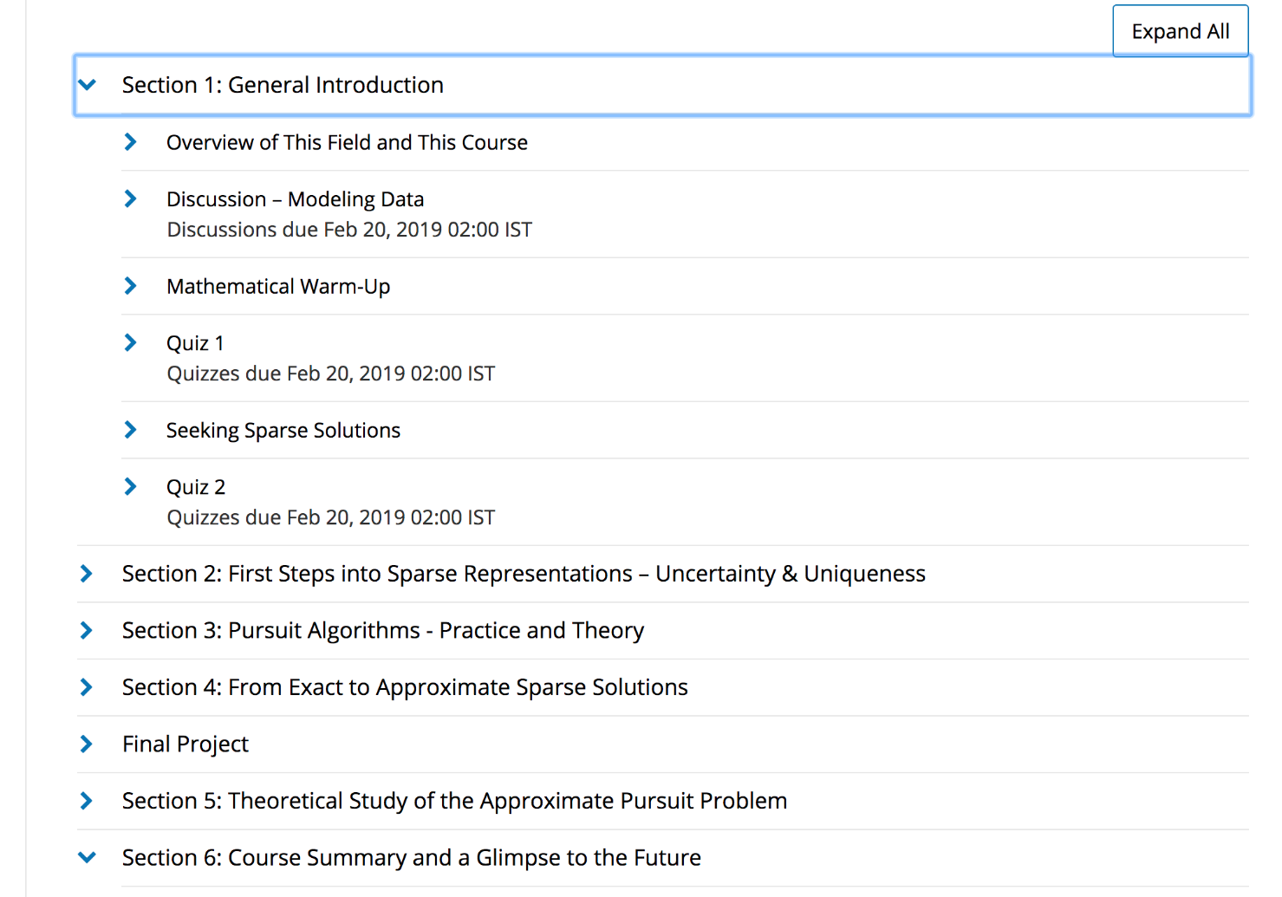
Course Structure
5 Sections (+1)

Slide 21
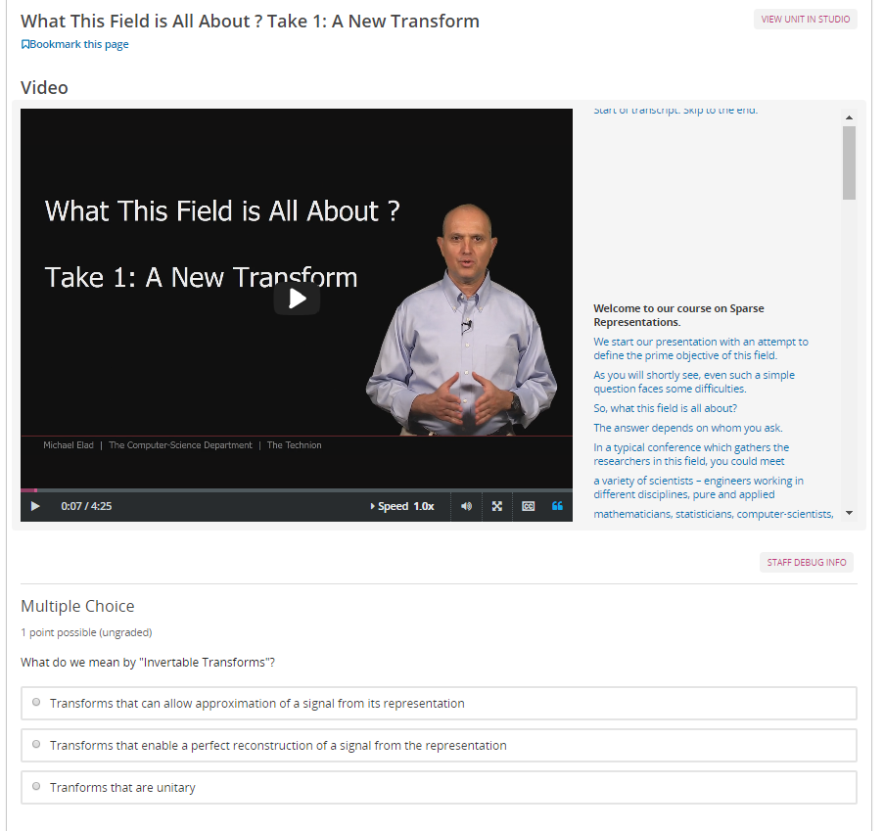
Course Structure
5 Sections (+1)
Each contains videos and knowledge-check questions

Slide 22
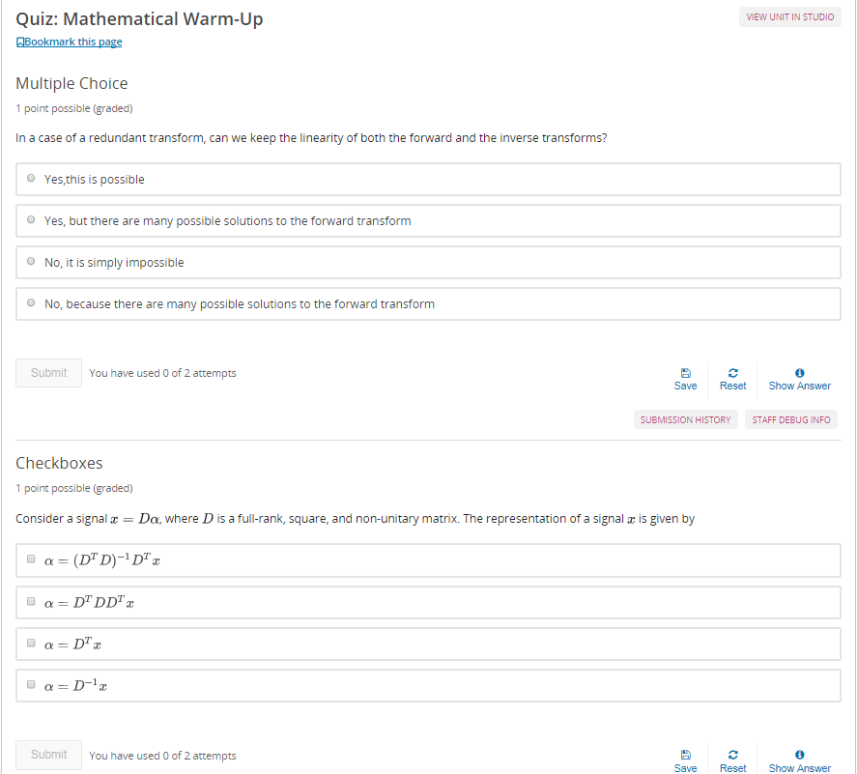
Course Structure
5 Sections (+1)
Each contains videos and knowledge-check questions
Each contains quizzes (multiple choice questions)

Slide 23
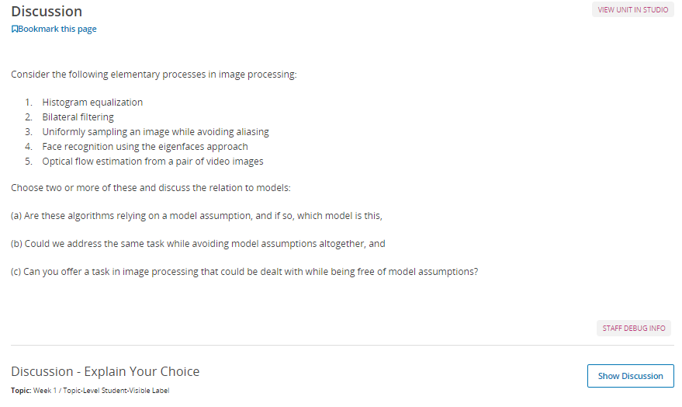
Course Structure
5 Sections (+1)
Each contains videos and knowledge-check questions
Each contains quizzes (multiple choice questions)
Two of them include a discussion

Slide 24
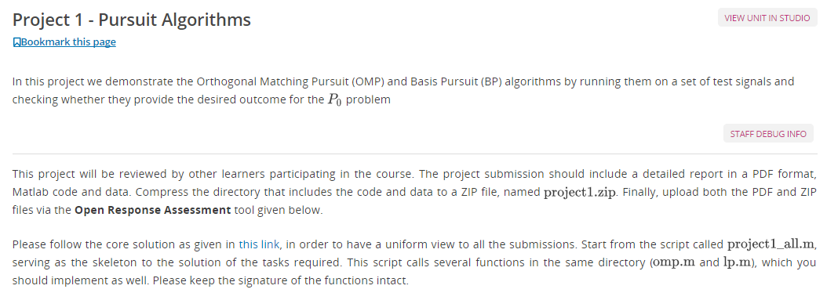
Course Structure
5 Sections (+1)
Each contains videos and knowledge-check questions
Each contains quizzes (multiple choice questions)
Two of them include a discussion
Two of them include a Matlab project

Slide 25
Matlab Projects
Project 1 (Released: 4.11, Due: 25.11 3:00 am):
3 weeks to submit the report and code
Project 2 (Released: 11.11, Due: 16.12 3:00 am):
5 weeks to submit the report and code
The deadlines are also written in edX. Note that deadlines in edX are in UTC. It is your responsibility to submit the response in time. If not, the assignment cannot be evaluated in edX and your grade will be zero.
Start working on the assignments before the class assembles (there is a delay of 1.5 weeks) !!
Special reception hours will be announced

Slide 26
Submission in Matlab/Python*
Course participants will get a license for Matlab Online for the duration of the course.
You can choose to submit the assignments in Matlab/Python*.
NOTE: SKELETON FILES ARE WRITTEN IN MATLAB.
If you wish to submit in Python, you must re-write the skeleton files such that they provide the same output. Debugging advice in Python is not as of yet supported by course staff. It is your own responsibility.
Those who do wish to submit in Python and re-write the skeleton, will get a bonus in their grade.

Slide 27
Second Part of the Course
Professional Certificate Program Sparse Representations in Signal and Image Processing
First Course Sparse Representations in Signal and Image Processing: Fundamentals
You are here!
Second Course Sparse Representations in Image Processing: From Theory to Practice

Slide 28
Second Part is Self-Paced
All material, including videos, quizzes, discussions and Matlab assignments, is available throughout the entire duration of the course: October 21st 2018 – March 21st 2019.
The deadlines for the assignments will be announced in class. The deadlines in edX in the second part of the course can be ignored.

Slide 29
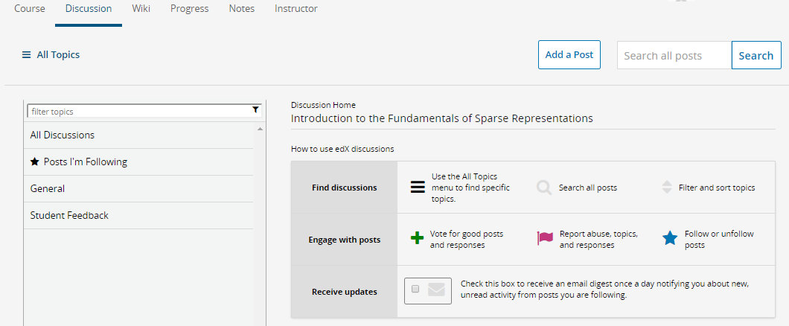
Need Help? Want to Share Your Thoughts?
If this is edX related, please use the forums
If it relates solely to the Technion’s course - contact us directly Most active participants which will provide helpful and insightful responses can be promoted to “Community TA” status
Report bugs or leave a feedback

Slide 30
That’s it… Good Luck!!

